Slide 1
Anomaly detection in large graphs
Christos Faloutsos
CMU

Slide 2
Thank you!
Prof. Reddy
Etc
etc

Slide 3
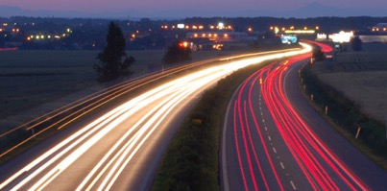
Roadmap
Introduction – Motivation
Why study (big) graphs?
Part#1: Patterns in graphs
Part#2: time-evolving graphs; tensors
Conclusions

Slide 4






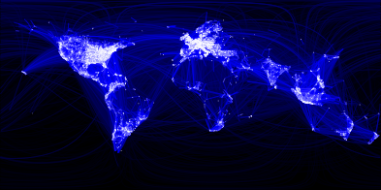
Graphs - why should we care?
>$10B; ~1B users

Slide 5
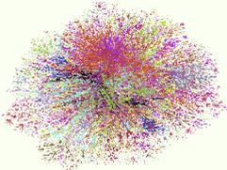
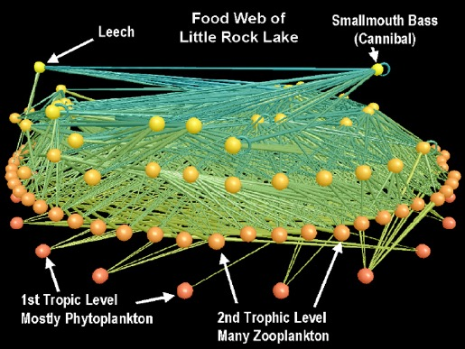
Graphs - why should we care?
Internet Map [lumeta.com]
Food Web [Martinez ’91]

Slide 6

Graphs - why should we care?
web-log (‘blog’) news propagation
computer network security: email/IP traffic and anomaly detection
Recommendation systems
....
Many-to-many db relationship -> graph

Slide 7
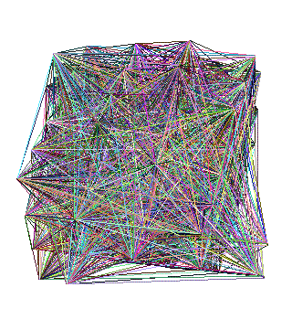
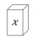
Motivating problems
P1: patterns? Fraud detection?
P2: patterns in time-evolving graphs / tensors
destination
source
time

Slide 8

Motivating problems
P1: patterns? Fraud detection?
P2: patterns in time-evolving graphs / tensors
Patterns anomalies
destination
source
time

Slide 9
Motivating problems
P1: patterns? Fraud detection?
P2: patterns in time-evolving graphs / tensors
Patterns anomalies*
destination
source
time
* Robust Random Cut Forest Based Anomaly Detection on Streams Sudipto Guha, Nina Mishra , Gourav Roy, Okke Schrijvers, ICML’16

Slide 10
Roadmap
Introduction – Motivation
Why study (big) graphs?
Part#1: Patterns & fraud detection
Part#2: time-evolving graphs; tensors
Conclusions

Slide 11
Part 1:
Patterns, &
fraud detection

Slide 12
Laws and patterns
Q1: Are real graphs random?

Slide 13

Laws and patterns
Q1: Are real graphs random?
A1: NO!!
Diameter (‘6 degrees’; ‘Kevin Bacon’)
in- and out- degree distributions
other (surprising) patterns
So, let’s look at the data

Slide 14
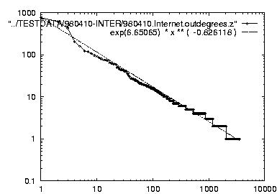
Solution# S.1
Power law in the degree distribution [Faloutsos x 3 SIGCOMM99]
internet domains
att.com
log(degree)
ibm.com
log(rank)

Slide 15
Solution# S.1
Power law in the degree distribution [Faloutsos x 3 SIGCOMM99]
internet domains
att.com
log(degree)
ibm.com
-0.82
log(rank)

Slide 16

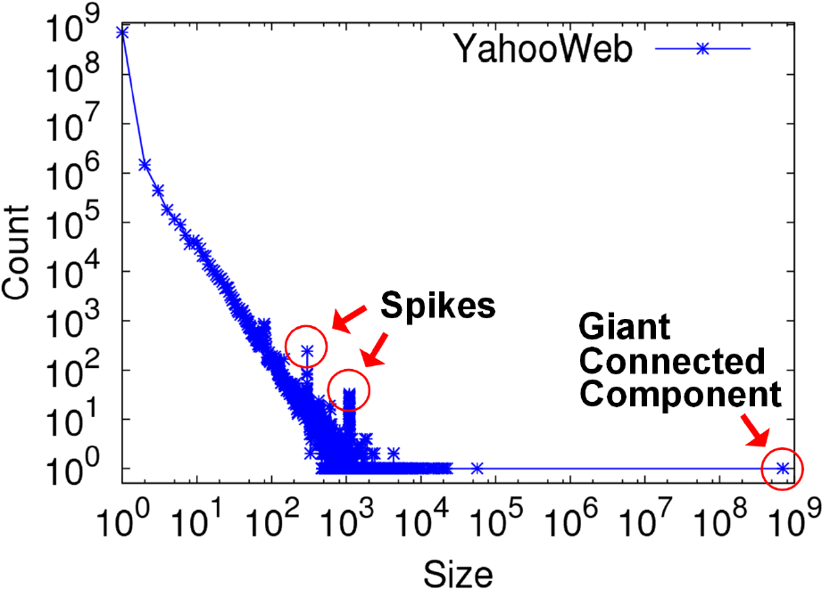
S2: connected component sizes
Connected Components – 4 observations:
Count
1.4B nodes
6B edges
Size

Slide 17
S2: connected component sizes
Connected Components
Count
1) 10K x
larger
than next
Size

Slide 18
S2: connected component sizes
Connected Components
Count
2) ~0.7B
singleton
nodes
Size

Slide 19
S2: connected component sizes
Connected Components
Count
3) SLOPE!
Size

Slide 20
S2: connected component sizes
Connected Components
Count
300-size cmpt
X 500.
Why?
1100-size cmpt
X 65.
Why?
4) Spikes!
Size

Slide 21
S2: connected component sizes
Connected Components
Count
suspicious
financial-advice sites
(not existing now)
Size

Slide 22
Roadmap
Introduction – Motivation
Part#1: Patterns in graphs
P1.1: Patterns: Degree; Triangles
P1.2: Anomaly/fraud detection
Part#2: time-evolving graphs; tensors
Conclusions

Slide 23
Solution# S.3: Triangle ‘Laws’
Real social networks have a lot of triangles

Slide 24
Solution# S.3: Triangle ‘Laws’
Real social networks have a lot of triangles
Friends of friends are friends
Any patterns?
2x the friends, 2x the triangles ?

Slide 25
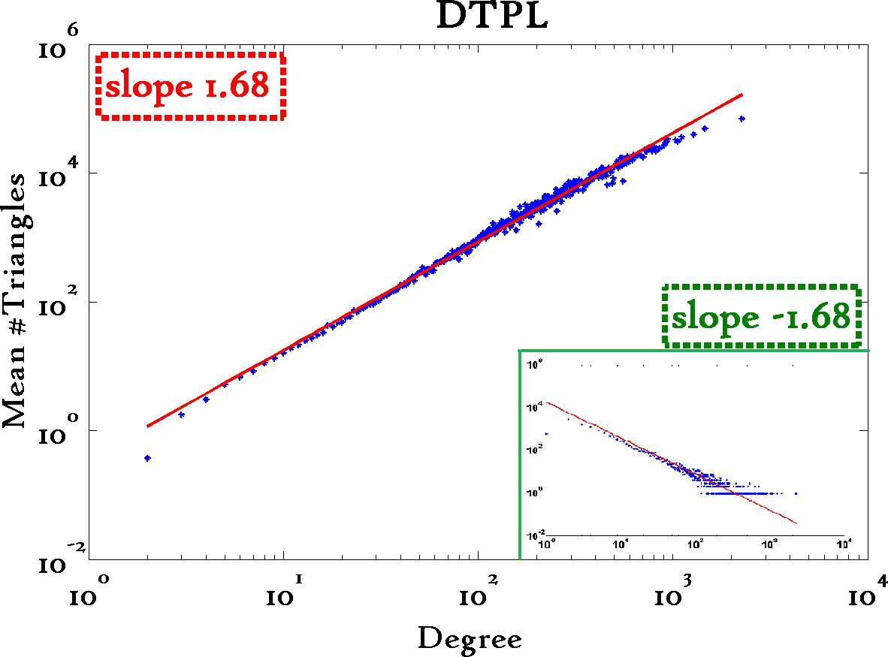
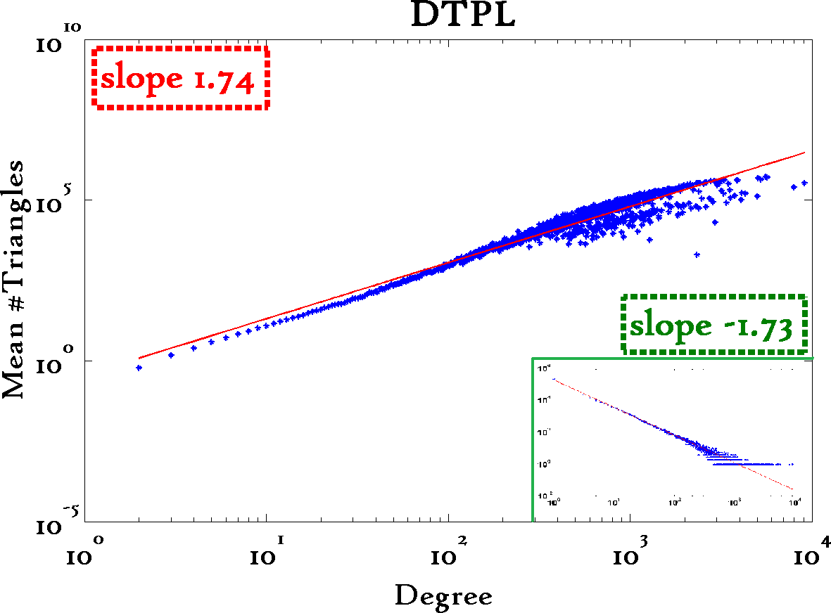
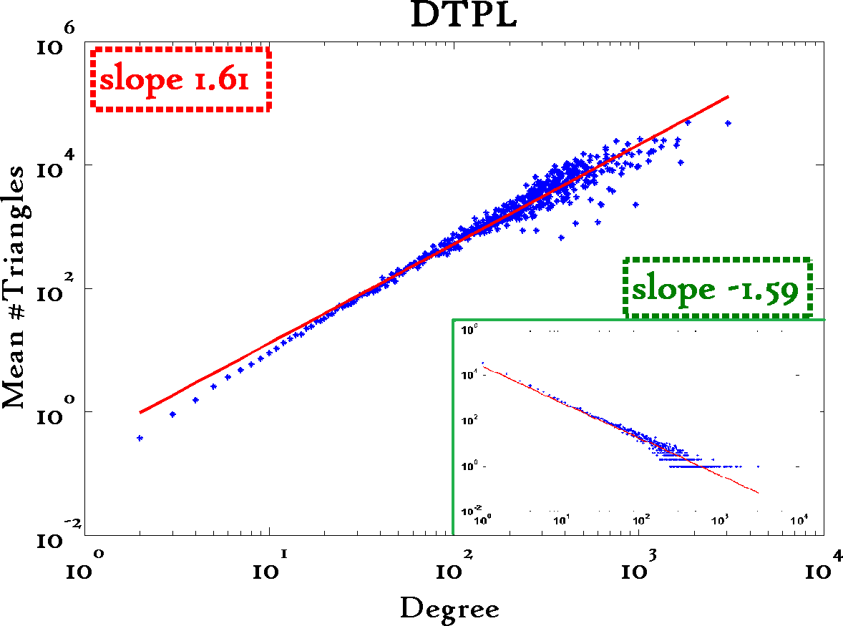
Triangle Law: #S.3 [Tsourakakis ICDM 2008]
Reuters
SN
X-axis: degree
Y-axis: mean # triangles
n friends -> ~n^{1.6} triangles
Epinions

Slide 26
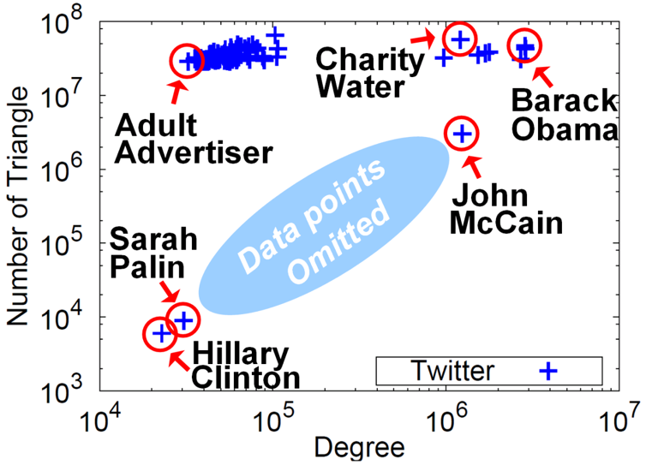




Triangle counting for large graphs?
Anomalous nodes in Twitter(~ 3 billion edges)
[U Kang, Brendan Meeder, +, PAKDD’11]
?
?
?
26

Slide 27
Triangle counting for large graphs?
Anomalous nodes in Twitter(~ 3 billion edges)
[U Kang, Brendan Meeder, +, PAKDD’11]
27

Slide 28
Triangle counting for large graphs?
Anomalous nodes in Twitter(~ 3 billion edges)
[U Kang, Brendan Meeder, +, PAKDD’11]
28

Slide 29
Triangle counting for large graphs?
Anomalous nodes in Twitter(~ 3 billion edges)
[U Kang, Brendan Meeder, +, PAKDD’11]
29

Slide 30
Triangle counting for large graphs?
Anomalous nodes in Twitter(~ 3 billion edges)
[U Kang, Brendan Meeder, +, PAKDD’11]
30

Slide 31
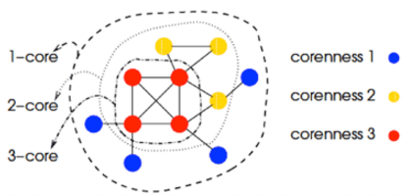
S4: k-core patterns - dfn
k-core (of a graph)
degeneracy (of a graph)
coreness (of a vertex)

Slide 32
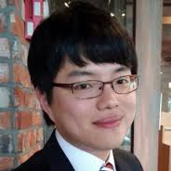
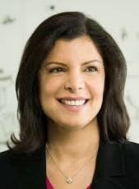
CoreScope: Graph Mining Using k-Core Analysis - Patterns, Anomalies, and Algorithms
ICDM’16 (to appear)
Kijung Shin, Tina Eliassi-Rad and CF

Slide 33
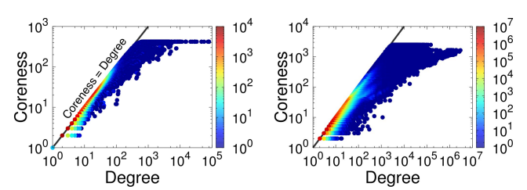
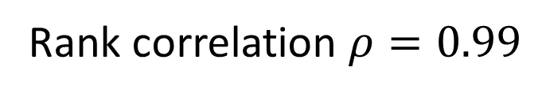
Mirror Pattern: Observation
coreness (of a vertex): maximum k such that the vertex belongs to the k-core
Definition: [Mirror Pattern] degree ~ coreness

Slide 34
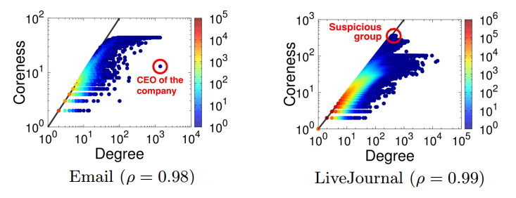
Mirror Pattern: Application
Exceptions are ‘strange’

Slide 35
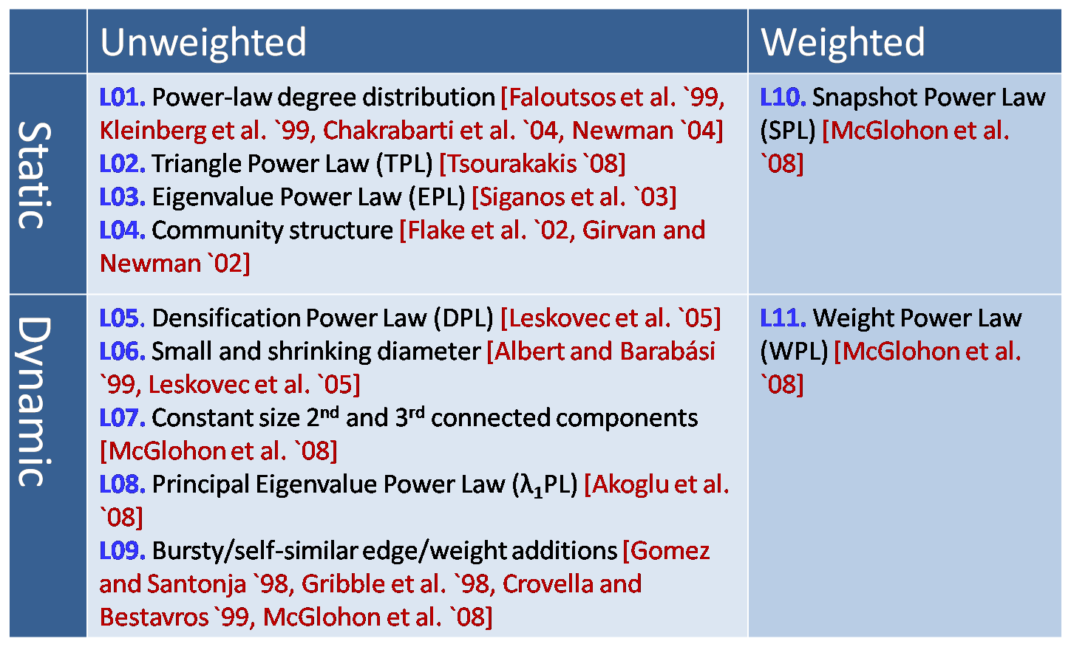
MORE Graph Patterns
✔
✔
✔
RTG: A Recursive Realistic Graph Generator using Random Typing Leman Akoglu and Christos Faloutsos. PKDD’09.

Slide 36
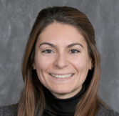
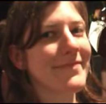
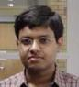

MORE Graph Patterns
Mary McGlohon, Leman Akoglu, Christos Faloutsos. Statistical Properties of Social Networks. in "Social Network Data Analytics” (Ed.: Charu Aggarwal)
Deepayan Chakrabarti and Christos Faloutsos, Graph Mining: Laws, Tools, and Case Studies Oct. 2012, Morgan Claypool.

Slide 37
Roadmap
Introduction – Motivation
Part#1: Patterns in graphs
P1.1: Patterns
P1.2: Anomaly / fraud detection
No labels – spectral
With labels: Belief Propagation
Part#2: time-evolving graphs; tensors
Conclusions
Patterns anomalies

Slide 38
How to find ‘suspicious’ groups?
‘blocks’ are normal, right?
idols
fans

Slide 39

Except that:
‘blocks’ are normal, right?
‘hyperbolic’ communities are more realistic [Araujo+, PKDD’14]

Slide 40
Except that:
‘blocks’ are usually suspicious
‘hyperbolic’ communities are more realistic [Araujo+, PKDD’14]
Q: Can we spot blocks, easily?

Slide 41
Except that:
‘blocks’ are usually suspicious
‘hyperbolic’ communities are more realistic [Araujo+, PKDD’14]
Q: Can we spot blocks, easily?
A: Silver bullet: SVD!

Slide 42
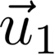
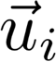
Crush intro to SVD
DETAILS
Recall: (SVD) matrix factorization: finds blocks
‘music lovers’
‘singers’
‘sports lovers’
‘athletes’
‘citizens’
‘politicians’
M
idols
N
fans
+
+
~

Slide 43

Crush intro to SVD
DETAILS
Recall: (SVD) matrix factorization: finds blocks
‘meat-eaters’
‘steaks’
‘vegetarians’
‘plants’
‘kids’
‘cookies’
M
products
N
users
+
+
~

Slide 44


Crush intro to SVD
DETAILS
Recall: (SVD) matrix factorization: finds blocks
‘cancer’
‘alzheimer’
‘Parkinson’
M
timestamps
N genes
~
+
+

Slide 45

Crush intro to SVD
DETAILS
Recall: (SVD) matrix factorization: finds blocks
‘hurricane’
‘cold-spell’
‘heat-wave’
M
timestamps
N locations
~
+
+

Slide 46
Crush intro to SVD
DETAILS
Recall: (SVD) matrix factorization: finds blocks
‘music lovers’
‘singers’
‘sports lovers’
‘athletes’
‘citizens’
‘politicians’
M
idols
N
fans
+
+
~

Slide 47
Crush intro to SVD
DETAILS
Recall: (SVD) matrix factorization: finds blocks
‘music lovers’
‘singers’
‘sports lovers’
‘athletes’
‘citizens’
‘politicians’
M
idols
N
fans
+
+
~

Slide 48
Crush intro to SVD
DETAILS
Recall: (SVD) matrix factorization: finds blocks
Even if shuffled!
‘music lovers’
‘singers’
‘sports lovers’
‘athletes’
‘citizens’
‘politicians’
M
idols
N
fans
+
+
~

Slide 49

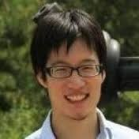
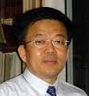

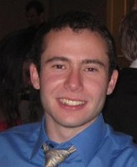
Inferring Strange Behavior from Connectivity Pattern in Social Networks PAKDD’14
Meng Jiang, Peng Cui, Shiqiang Yang (Tsinghua)
Alex Beutel, Christos Faloutsos (CMU)

Slide 50
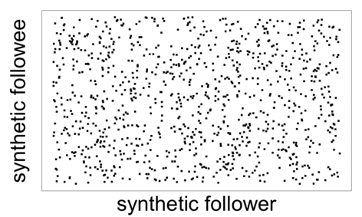
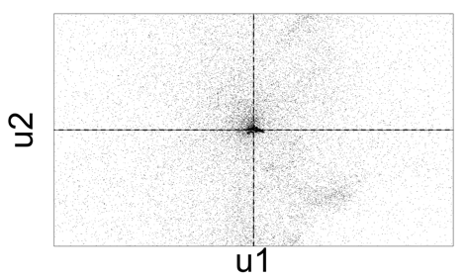
Lockstep and Spectral Subspace Plot
Case #0: No lockstep behavior in random power law graph of 1M nodes, 3M edges
Random “Scatter”
Adjacency Matrix
Spectral Subspace Plot
+
+

Slide 51
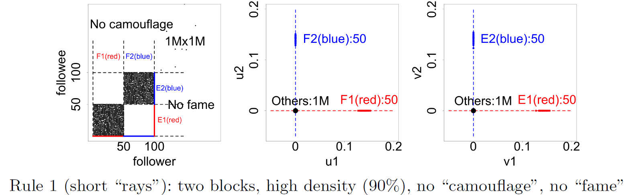
Lockstep and Spectral Subspace Plot
Case #1: non-overlapping lockstep
“Blocks” “Rays”
Adjacency Matrix
Spectral Subspace Plot

Slide 52
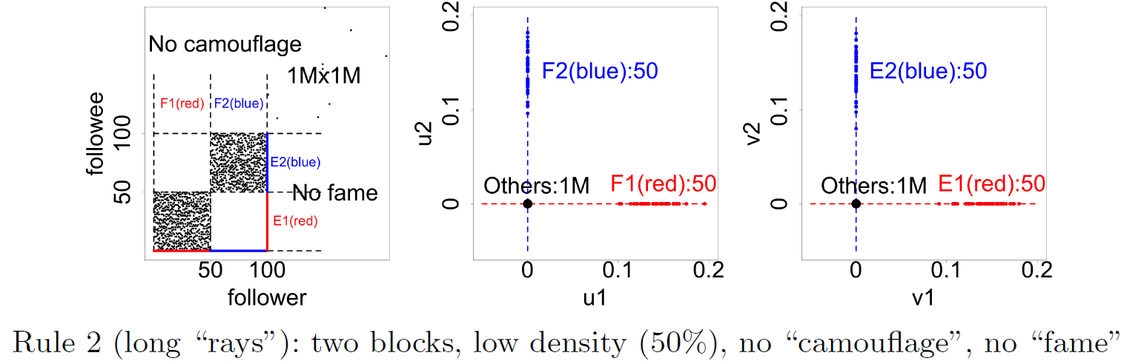
Lockstep and Spectral Subspace Plot
Case #2: non-overlapping lockstep
“Blocks; low density” Elongation
Adjacency Matrix
Spectral Subspace Plot

Slide 53
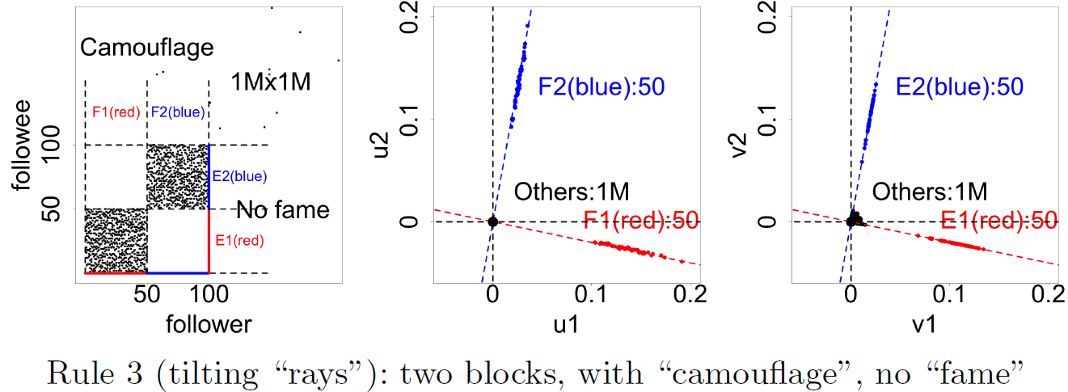
Lockstep and Spectral Subspace Plot
Case #3: non-overlapping lockstep
“Camouflage” (or “Fame”) Tilting “Rays”
Adjacency Matrix
Spectral Subspace Plot

Slide 54
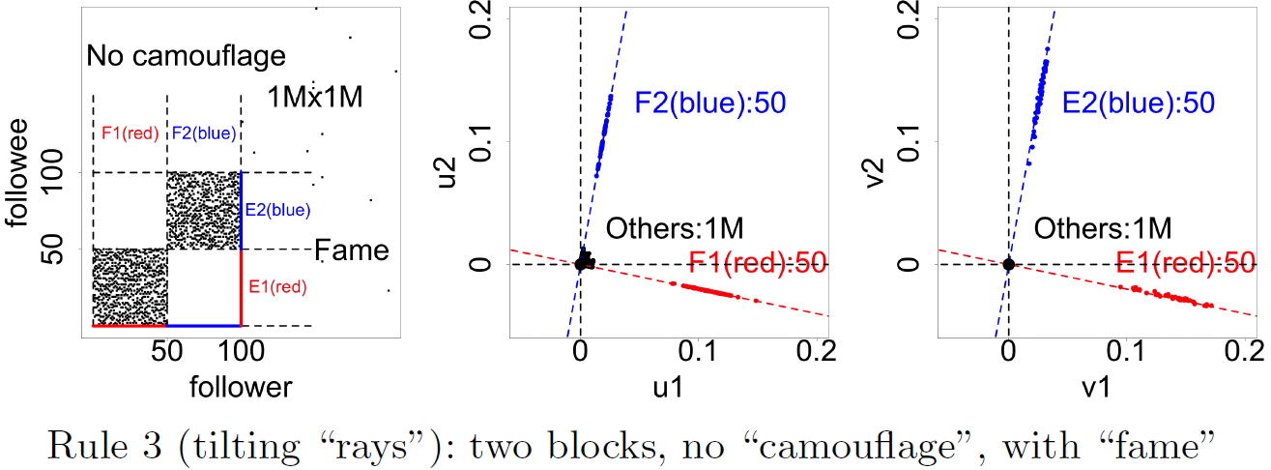
Lockstep and Spectral Subspace Plot
Case #3: non-overlapping lockstep
“Camouflage” (or “Fame”) Tilting “Rays”
Adjacency Matrix
Spectral Subspace Plot

Slide 55
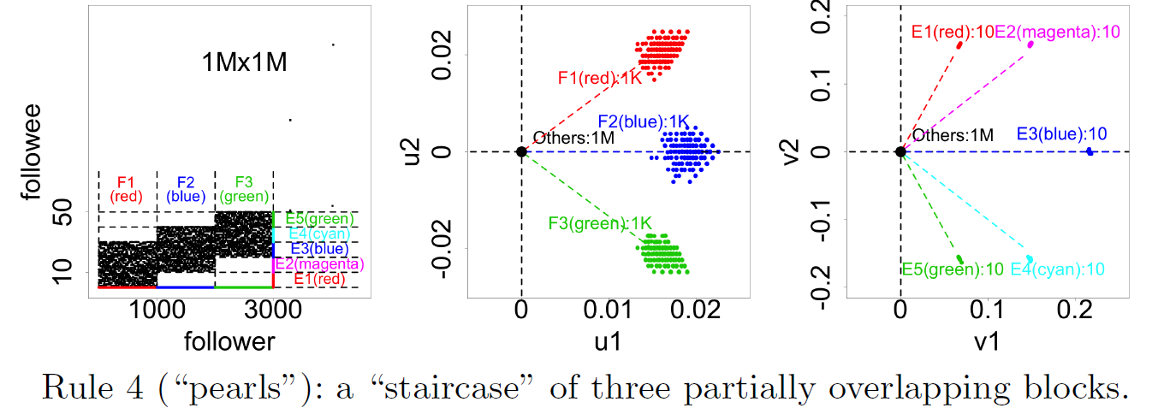
Lockstep and Spectral Subspace Plot
Case #4: ? lockstep
“?” “Pearls”
Adjacency Matrix
Spectral Subspace Plot
?

Slide 56
Lockstep and Spectral Subspace Plot
Case #4: overlapping lockstep
“Staircase” “Pearls”
Adjacency Matrix
Spectral Subspace Plot

Slide 57


Dataset
Tencent Weibo
117 million nodes (with profile and UGC data)
3.33 billion directed edges

Slide 58
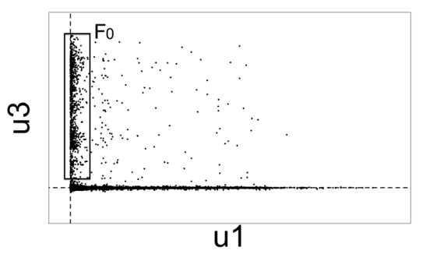
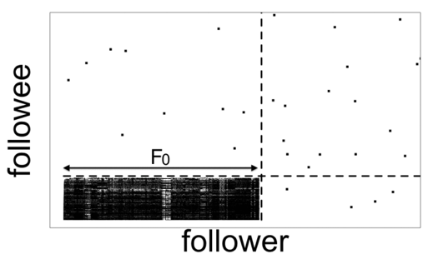
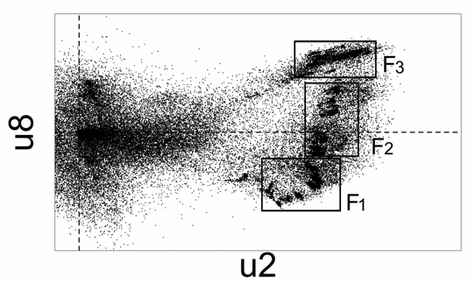
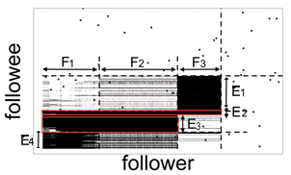
Real Data
“Rays”
“Block”
“Pearls”
“Staircase”

Slide 59

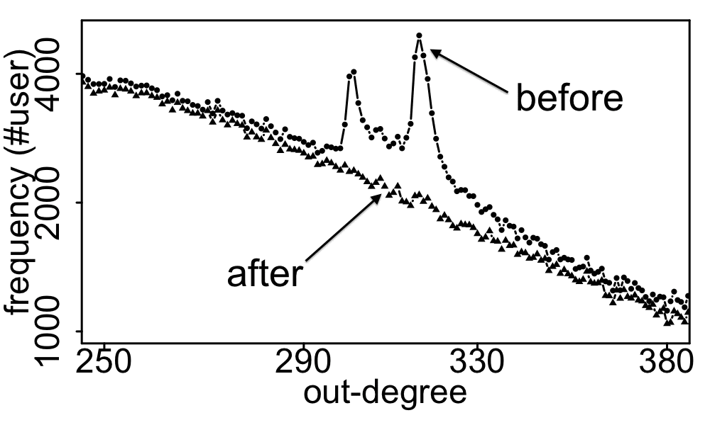
Real Data
Spikes on the out-degree distribution
×
×

Slide 60
Roadmap
Introduction – Motivation
Part#1: Patterns in graphs
P1.1: Patterns
P1.2: Anomaly / fraud detection
No labels – spectral methods
Suspiciousness
With labels: Belief Propagation
Part#2: time-evolving graphs; tensors
Conclusions

Slide 61
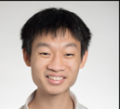



Suspicious Patterns in Event Data
?
2-modes
?
?
n-modes
A General Suspiciousness Metric for Dense Blocks in Multimodal Data, Meng Jiang, Alex Beutel, Peng Cui, Bryan Hooi, Shiqiang Yang, and Christos Faloutsos, ICDM, 2015.

Slide 62
Suspicious Patterns in Event Data
ICDM 2015
Which is more suspicious?
20,000 Users
Retweeting same 20 tweets
6 times each
All in 10 hours
225 Users
Retweeting same 1 tweet
15 times each
All in 3 hours
All from 2 IP addresses
vs.

Slide 63
Suspicious Patterns in Event Data
ICDM 2015
Which is more suspicious?
20,000 Users
Retweeting same 20 tweets
6 times each
All in 10 hours
225 Users
Retweeting same 1 tweet
15 times each
All in 3 hours
All from 2 IP addresses
vs.
Answer: volume * D_{KL}(p|| p_{background})

Slide 64
Suspicious Patterns in Event Data
ICDM 2015
Which is more suspicious?
20,000 Users
Retweeting same 20 tweets
6 times each
All in 10 hours
225 Users
Retweeting same 1 tweet
15 times each
All in 3 hours
All from 2 IP addresses
vs.
size
contrast
Answer: volume * D_{KL}(p|| p_{background})

Slide 65

Suspicious Patterns in Event Data
ICDM 2015
Retweeting: “Galaxy Note Dream Project: Happy Happy Life Traveling the World”

Slide 66
Roadmap
Introduction – Motivation
Part#1: Patterns in graphs
P1.1: Patterns
P1.2: Anomaly / fraud detection
No labels – spectral methods
With labels: Belief Propagation
Part#2: time-evolving graphs; tensors
Conclusions

Slide 67


E-bay Fraud detection
w/ Polo Chau &
Shashank Pandit, CMU
[www’07]

Slide 68
E-bay Fraud detection

Slide 69
E-bay Fraud detection

Slide 70
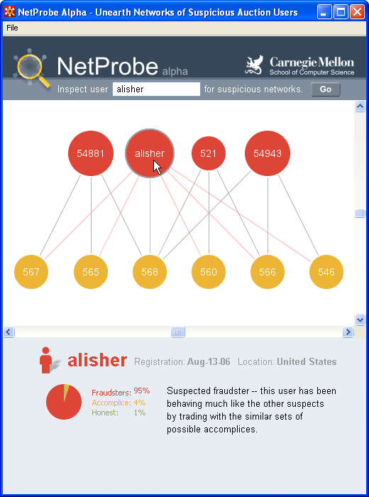
E-bay Fraud detection - NetProbe

Slide 71


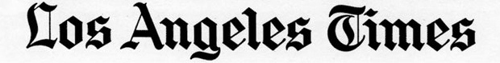
Popular press
And less desirable attention:
E-mail from ‘Belgium police’ (‘copy of your code?’)

Slide 72
Roadmap
Introduction – Motivation
Part#1: Patterns in graphs
Patterns
Anomaly / fraud detection
No labels - Spectral methods
w/ labels: Belief Propagation – closed formulas
Part#2: time-evolving graphs; tensors
Conclusions

Slide 73
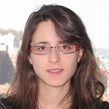
Unifying Guilt-by-Association Approaches: Theorems and Fast Algorithms
Danai Koutra
U Kang
Hsing-Kuo Kenneth Pao
Tai-You Ke
Duen Horng (Polo) Chau
Christos Faloutsos
ECML PKDD, 5-9 September 2011, Athens, Greece
Notes:
Work in collaboration with National Taiwan University

Slide 74
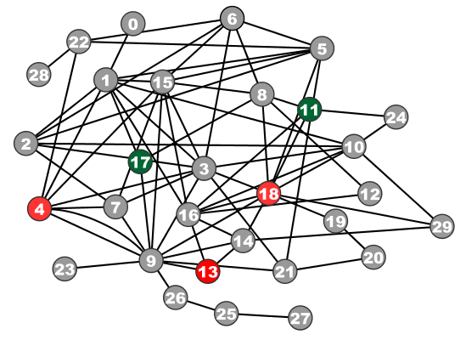
Problem Definition: GBA techniques
?
Given: Graph; &
few labeled nodes
Find: labels of rest
(assuming network effects)
?
?
?
Notes:
Classification problem where we assume that neighboring nodes are related
Network effects – birds of a feather flock together

Slide 75

Are they related?
RWR (Random Walk with Restarts)
google’s pageRank (‘if my friends are important, I’m important, too’)
SSL (Semi-supervised learning)
minimize the differences among neighbors
BP (Belief propagation)
send messages to neighbors, on what you believe about them

Slide 76
Are they related?
YES!
RWR (Random Walk with Restarts)
google’s pageRank (‘if my friends are important, I’m important, too’)
SSL (Semi-supervised learning)
minimize the differences among neighbors
BP (Belief propagation)
send messages to neighbors, on what you believe about them

Slide 77
Correspondence of Methods
Method | Matrix |  | Unknown |  | known
RWR | [I – c AD⁻¹] | × | x | = | (1-c)y
SSL | [I + a(D - A)] | × | x | = | y
FABP | [I + a D - c’A] | × | b_{h} | = | φ_{h}
1
1
1
d1
d2
d3
0 1 0
1 0 1
0 1 0
?
0
1
1
adjacency matrix
final labels/ beliefs
prior labels/ beliefs

Slide 78

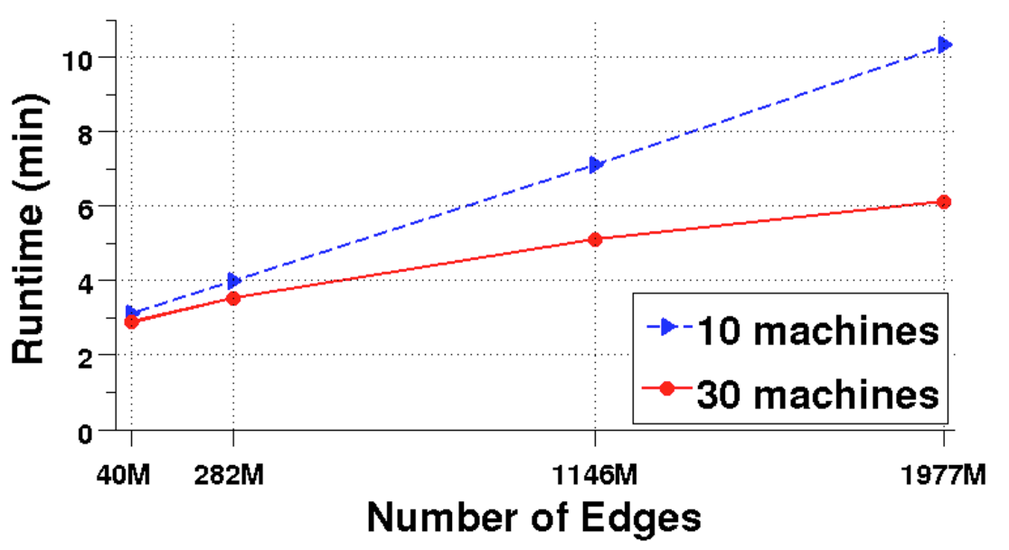
Results: Scalability
runtime (min)
# of edges (Kronecker graphs)
FABP is linear on the number of edges.
Notes:
Kronecker graphs

Slide 79
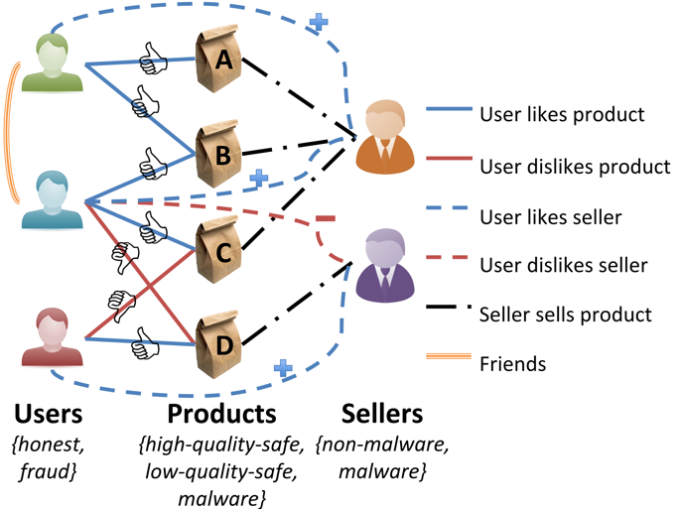
Problem: e-commerce ratings fraud
Given a heterogeneous graph on users, products, sellers and positive/negative ratings with “seed labels”
Find the top k most fraudulent users, products and sellers

Slide 80
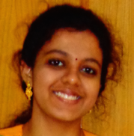
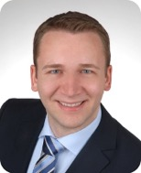
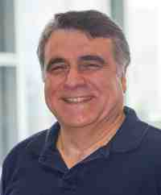
Problem: e-commerce ratings fraud
Given a heterogeneous graph on users, products, sellers and positive/negative ratings with “seed labels”
Find the top k most fraudulent users, products and sellers
Dhivya Eswaran, Stephan Günnemann, Christos Faloutsos, “ZooBP: Belief Propagation for Heterogeneous Networks”, In submission to VLDB 2017

Slide 81
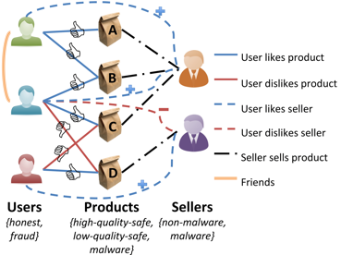

Problem: e-commerce ratings fraud
Dhivya Eswaran, Stephan Günnemann, Christos Faloutsos, “ZooBP: Belief Propagation for Heterogeneous Networks”, In submission to VLDB 2017

Slide 82


ZooBP: features
Fast; convergence guarantees.
Near-perfect accuracy
linear in graph size
Dhivya Eswaran, Stephan Günnemann, Christos Faloutsos, “ZooBP: Belief Propagation for Heterogeneous Networks”, In submission to VLDB 2017

Slide 83

ZooBP in the real world
Near 100% precision on top 300 users (Flipkart)
Flagged users: suspicious
400 ratings in 1 sec
5000 good ratings and no bad ratings
Dhivya Eswaran, Stephan Günnemann, Christos Faloutsos, “ZooBP: Belief Propagation for Heterogeneous Networks”, In submission to VLDB 2017

Slide 84


Summary of Part#1
*many* patterns in real graphs
Power-laws everywhere
Long (and growing) list of tools for anomaly/fraud detection
Patterns anomalies

Slide 85
Roadmap
Introduction – Motivation
Part#1: Patterns in graphs
Part#2: time-evolving graphs
P2.1: tools/tensors
P2.2: other patterns
Conclusions

Slide 86
Part 2:
Time evolving
graphs; tensors

Slide 87
Graphs over time -> tensors!
Problem #2.1:
Given who calls whom, and when
Find patterns / anomalies
johnson
smith

Slide 88
Graphs over time -> tensors!
Problem #2.1:
Given who calls whom, and when
Find patterns / anomalies

Slide 89
Graphs over time -> tensors!
Problem #2.1:
Given who calls whom, and when
Find patterns / anomalies
Tue
Mon

Slide 90
Graphs over time -> tensors!
Problem #2.1:
Given who calls whom, and when
Find patterns / anomalies
time
caller
callee

Slide 91
Graphs over time -> tensors!
Problem #2.1’:
Given author-keyword-date
Find patterns / anomalies
date
MANY more settings,
with >2 ‘modes’
author
keyword

Slide 92
Graphs over time -> tensors!
Problem #2.1’’:
Given subject – verb – object facts
Find patterns / anomalies
verb
MANY more settings,
with >2 ‘modes’
subject
object

Slide 93
Graphs over time -> tensors!
Problem #2.1’’’:
Given <triplets>
Find patterns / anomalies
mode3
MANY more settings,
with >2 ‘modes’
(and 4, 5, etc modes)
mode1
mode2

Slide 94
Answer : tensor factorization
Recall: (SVD) matrix factorization: finds blocks
‘meat-eaters’
‘steaks’
‘vegetarians’
‘plants’
‘kids’
‘cookies’
M
products
N
users
+
+
~

Slide 95
Crush intro to SVD
Recall: (SVD) matrix factorization: finds blocks
‘music lovers’
‘singers’
‘sports lovers’
‘athletes’
‘citizens’
‘politicians’
M
idols
N
fans
+
+
~

Slide 96
Answer: tensor factorization
PARAFAC decomposition
politicians
artists
athletes
verb
subject
+
+
=
object

Slide 97
Answer: tensor factorization
PARAFAC decomposition
Results for who-calls-whom-when
4M x 15 days
??
??
??
time
caller
+
+
=
callee

Slide 98



Anomaly detection in time-evolving graphs
=
Anomalous communities in phone call data:
European country, 4M clients, data over 2 weeks
~200 calls to EACH receiver on EACH day!
1 caller
5 receivers
4 days of activity

Slide 99
Anomaly detection in time-evolving graphs
=
Anomalous communities in phone call data:
European country, 4M clients, data over 2 weeks
~200 calls to EACH receiver on EACH day!
1 caller
5 receivers
4 days of activity

Slide 100



Anomaly detection in time-evolving graphs
=
Anomalous communities in phone call data:
European country, 4M clients, data over 2 weeks
~200 calls to EACH receiver on EACH day!
Miguel Araujo, Spiros Papadimitriou, Stephan Günnemann, Christos Faloutsos, Prithwish Basu, Ananthram Swami,
Evangelos Papalexakis, Danai Koutra. Com2: Fast Automatic Discovery of Temporal (Comet) Communities. PAKDD 2014, Tainan, Taiwan.

Slide 101
Roadmap
Introduction – Motivation
Part#1: Patterns in graphs
Part#2: time-evolving graphs
P2.1: tools/tensors
P2.2: other patterns – inter-arrival time
Conclusions

Slide 102




RSC: Mining and Modeling Temporal Activity in Social Media
Universidade
de São Paulo
KDD 2015 – Sydney, Australia
Alceu F. Costa* Yuto Yamaguchi Agma J. M. Traina
Caetano Traina Jr. Christos Faloutsos
*alceufc@icmc.usp.br

Slide 103

Pattern Mining: Datasets
Reddit Dataset Time-stamp from comments 21,198 users 20 Million time-stamps | Twitter Dataset Time-stamp from tweets 6,790 users 16 Million time-stamps
For each user we have:
Sequence of postings time-stamps: T = (t₁, t₂, t₃, …)
Inter-arrival times (IAT) of postings: (∆₁, ∆₂, ∆₃, …)
∆₁
∆₂
∆₃
time
t₁
t₂
t₃
t₄
Notes:
In this work we analyzed data from two services: reddit and twitter
For the reddit dataset we have time-stamp sequences from over 20k users and
For the twitter dataset we have time-stamp sequences from over 6k users
For each user had at least a sequence of at least 900 time-stamps.
For the twitter dataset the time-stamps were from tweets.
For the reddit dataset the time-stamps were from user comments.
From each sequence of time-stamps we also computed the IAT (inter-arrival time) between postings

Slide 104
Pattern Mining
Pattern 1: Distribution of IAT is heavy-tailed
Users can be inactive for long periods of time before making new postings
IAT Complementary Cumulative Distribution Function (CCDF)
(log-log axis)
Reddit Users
Twitter Users
Notes:
The first pattern discovered from the datasets is the heavy tailed distribution of inter-arrival times.
The plots in this slide shows the tail part of the IAT distribution for reddit and twitter users in log-log axis.

Slide 105
Pattern Mining
Pattern 1: Distribution of IAT is heavy-tailed
Users can be inactive for long periods of time before making new postings
IAT Complementary Cumulative Distribution Function (CCDF)
(log-log axis)
No surprises –
Should we give up?
Reddit Users
Twitter Users
Notes:
The first pattern discovered from the datasets is the heavy tailed distribution of inter-arrival times.
The plots in this slide shows the tail part of the IAT distribution for reddit and twitter users in log-log axis.

Slide 106



Human? Robots?
linear
log

Slide 107
Human? Robots?
2’
3h
1day
linear
log

Slide 108
Experiments: Can RSC-Spotter Detect Bots?
Precision vs. Sensitivity Curves
Good performance: curve close to the top
Twitter
Precision > 94%
Sensitivity > 70%
With strongly imbalanced datasets
# humans >> # bots

Slide 109
Experiments: Can RSC-Spotter Detect Bots?
Precision vs. Sensitivity Curves
Good performance: curve close to the top
Reddit
Precision > 96%
Sensitivity > 47%
With strongly imbalanced datasets
# humans >> # bots

Slide 110
Roadmap
Introduction – Motivation
Part#1: Patterns in graphs
Part#2: time-evolving graphs
P2.1: tools/tensors
P2.2: other patterns
inter-arrival time
Network growth
Conclusions

Slide 111


Beyond Sigmoids: the NetTide Model for Social Network Growth and its Applications
KDD’’16
Chengxi Zang 臧承熙, Peng Cui, CF

Slide 112



PROBLEM: n(t) and e(t), over time?
n(t): the number of nodes.
e(t): the number of edges.
E.g.:
How many members will have next month?
How many friendship links will have next year?
Linear?
Exponential?
Sigmoid?
C
C/2
0

Slide 113
Datasets
WeChat 2011/1-2013/1 300M nodes, 4.75B links
ArXiv 1992/3-2002/3 17k nodes, 2.4M links
Enron 1998/1-2002/7 86K nodes, 600K links
Weibo 2006 165K nodes， 331K links

Slide 114



A: Power Law Growth
Cumulative growth（Log-Log scale）

Slide 115


Details
Proposed: NetTide Model
Nodes n(t)
Links e(t)
Notes:
In its place, we propose NETTIDE, along with differential equations for the growth of nodes, as well as links.

Slide 116

Details
NetTide-Node Model
$\frac{dn(t)}{dt}$ = $\frac{β}{t^{θ}}n(t)(N−n(t))$
Intuition:
Rich-get-richer
Limitation
Fizzling nature
= SI; ~Bass
Notes:
Let me show you model details.
The NetTide Model
Node: A social network with a large population n(t) has a propensity to attract more nodes.
As the population who can join the social network is limited, its growth will be constrained
The term β/tθ (t > 0) is the fizzling infection/excitement rate since the inception of the social network. That is, people have decaying excitement to infect their friends to join a social network. It is exactly the temporal fizzling exponent θ of the power law decay that leads to various growth dynamics

Slide 117
Details
NetTide-Node Model
#nodes(t)
Total population
Intuition:
Rich-get-richer
Limitation
Fizzling nature
= SI; ~Bass
Notes:
\frac{d n(t)}{dt} ~ = ~ \frac{\beta}{t^\theta} ~ n(t) ~ ( N - n(t) )
Let me show you model details.
The NetTide Model
Node: A social network with a large population n(t) has a propensity to attract more nodes.
As the population who can join the social network is limited, its growth will be constrained
The term β/tθ (t > 0) is the fizzling infection/excitement rate since the inception of the social network. That is, people have decaying excitement to infect their friends to join a social network. It is exactly the temporal fizzling exponent θ of the power law decay that leads to various growth dynamics

Slide 118








Results: Accuracy

Slide 119


Results: Accuracy

Slide 120


Results: Accuracy

Slide 121


Results: Accuracy

Slide 122


Results: Accuracy

Slide 123



Results: Forecast
WeChat from 100 million to 300 million
730 days ahead

Slide 124
Part 2: Conclusions
Time-evolving / heterogeneous graphs -> tensors
PARAFAC finds patterns
Surprising temporal patterns (P.L. growth)
=

Slide 125
Roadmap
Introduction – Motivation
Why study (big) graphs?
Part#1: Patterns in graphs
Part#2: time-evolving graphs; tensors
Acknowledgements and Conclusions

Slide 126








Thanks
Disclaimer: All opinions are mine; not necessarily reflecting the opinions of the funding agencies
Thanks to: NSF IIS-0705359, IIS-0534205,
CTA-INARC; Yahoo (M45), LLNL, IBM, SPRINT, Google, INTEL, HP, iLab

Slide 127












Cast
Akoglu,
Leman
Araujo,
Miguel
Beutel,
Alex
Chau,
Polo
Eswaran,
Dhivya
Hooi,
Bryan
Kang, U
Koutra,
Danai
Papalexakis,
Vagelis
Shah,
Neil
Shin,
Kijung
Song,
Hyun Ah

Slide 128



CONCLUSION#1 – Big data
Patterns Anomalies
Large datasets reveal patterns/outliers that are invisible otherwise

Slide 129
CONCLUSION#2 – tensors
powerful tool
=
1 caller
5 receivers
4 days of activity

Slide 130

References
D. Chakrabarti, C. Faloutsos: Graph Mining – Laws, Tools and Case Studies, Morgan Claypool 2012
http://www.morganclaypool.com/doi/abs/10.2200/S00449ED1V01Y201209DMK006

Slide 131

References
Danai Koutra and Christos Faloutsos, Individual and Collective Graph Mining: Principles, Algorithms, and Applications, Morgan Claypool 2017 (https://doi.org/10.2200/S00796ED1V01Y201708DMK014)

Slide 132

TAKE HOME MESSAGE:
Cross-disciplinarity
=

Slide 133
Thank you!
Cross-disciplinarity
=

